Slide 1


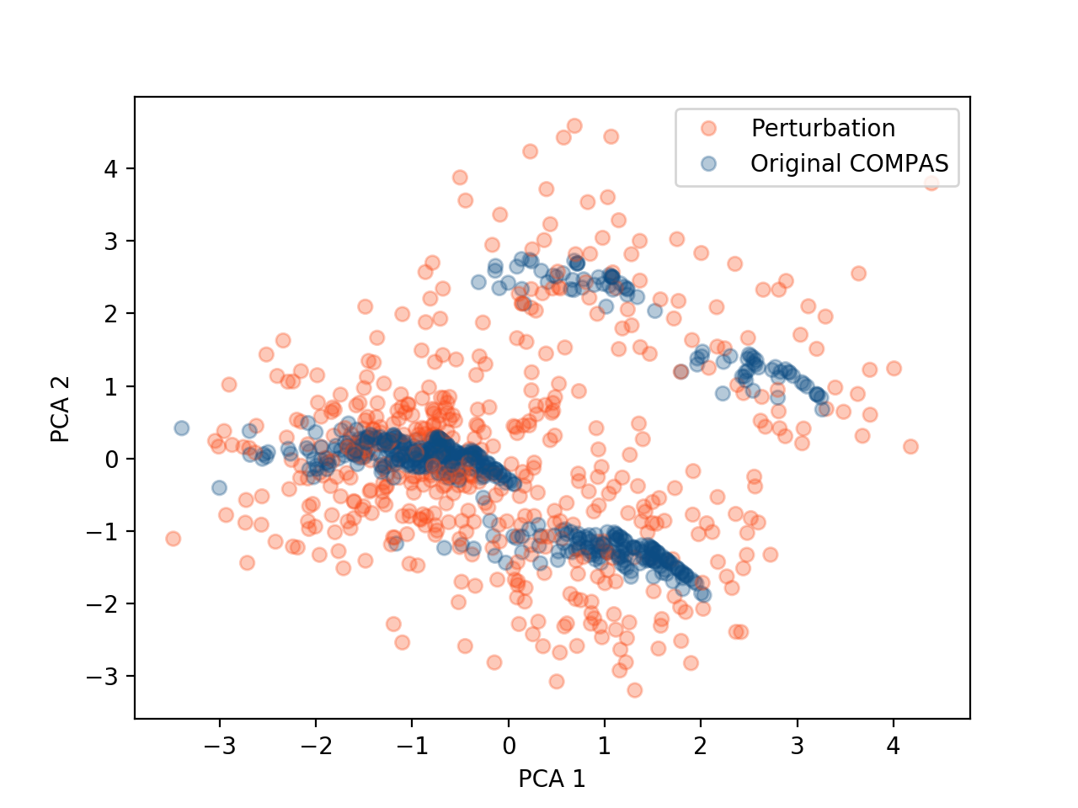
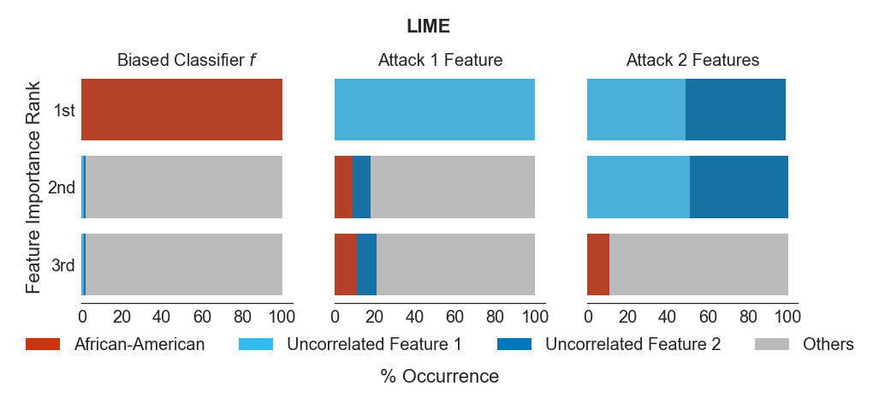
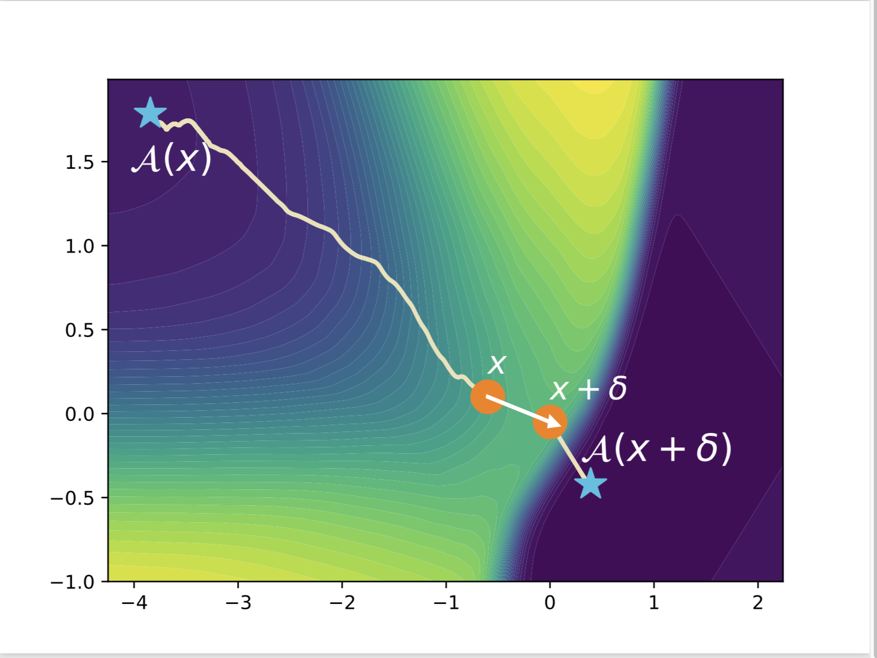
Feature Attributions and Counterfactual Explanations Can Be Manipulated
Dylan Slack*, Sophie Hilgard†, Sameer Singh*, Hima Lakkaraju†
*UC Irvine †Harvard University
Motivation
Manipulating Feature Attributions
ML models are used in high stakes decision making.
Model explanations establish trust in such settings.
Thus, explainability is a key part of ML pipelines.
Feature attribution methods sample perturbations.
However, perturbations are often out of distribution.
Adversaries can build scaffolded model that masks in distribution behavior with behavior on OOD data.
However, can adversaries design models to manipulate explanations?
LIME OOD Perturbation
In distribution, original instance.
Contributions
Explanations indicate race is important.
With attack, model hides reliance on race.
Yes! Feature attributions and counterfactual explanations (CFE’s) can be manipulated 😬.
Manipulating Counterfactual Explanations
Many CFE’s hill-climb the objective and are unstable.
Adversaries can design models that return low-cost counterfactuals under a perturbation.
Adversaries can produce low-cost counterfactuals by perturbing points for certain privileged individuals.
How?
Feature Attributions
Counterfactual Explanations
We can design a model where feature attributions return an arbitrary explanation.
It is possible to design models where counterfactual explanations conceal model biases.
Counterfactual found, A(x), for instance x is farther away from x than the counterfactual found for x+𝜹!
This example demonstrates how models can hide low-cost counterfactuals.

